Slide 1

DATA SCIENCE
10 WEEK PART TIME COURSE
Regularization, Pipelines

Slide 2
AGENDA

Slide 3
LASSO AND RIDGE REGRESSION
DATA SCIENCE - Week 4 Day 1

Slide 4
Linear regression when you don’t have much data

If you have a lot of columns, and not much data
Some of those columns are probably correlated a bit just by chance
You still want a simple model that can be explained in words, not maths
(This rules out reducing dimensions with PCA)
It can’t use too many variables
You don’t want tiny amounts of noise causing a more complex formula
Prediction =
3881.3 x ContractPrice
+ 0.0002 x PhaseOfTheMoon
- 3882.5 x FinalPrice
✔
Prediction =
1.2 x ContractPrice

Slide 5
HOW DOES REGULARIZATION WORK?
A tuning parameter lambda (or sometimes alpha) imposes a penalty on the size of coefficients.
Instead of minimizing the "loss function" (mean squared error), it minimizes the "loss plus penalty".
A tiny alpha imposes no penalty on the coefficient size, and is equivalent to a normal linear model.
Increasing the alpha penalizes the coefficients and shrinks them toward zero.

Slide 6
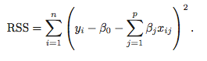
REGULARIZATION
Recall from Week 2 that the least squares procedure estimates coefficients that minimise
Regularization (or Shrinkage) is a way to constrain the estimates of beta to be close or equal to zero.
This is the coef_ array from LinearRegressor

Slide 7
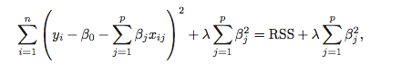
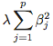
RIDGE REGRESSION
Ridge Regression is similar to least squares, except we include a penalty term,
the λ term is a tuning parameter. When it is zero we get least squares,
as it increases the term, (the shrinkage penalty) has more of an
impact and the coefficients will approach zero.
Really punish any coef_ that isn’t zero or very small

Slide 8
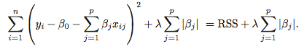
LASSO REGRESSION
Lasso Regression is similar to Ridge Regression, except we have the absolute value of beta in our penalty term,

Slide 9
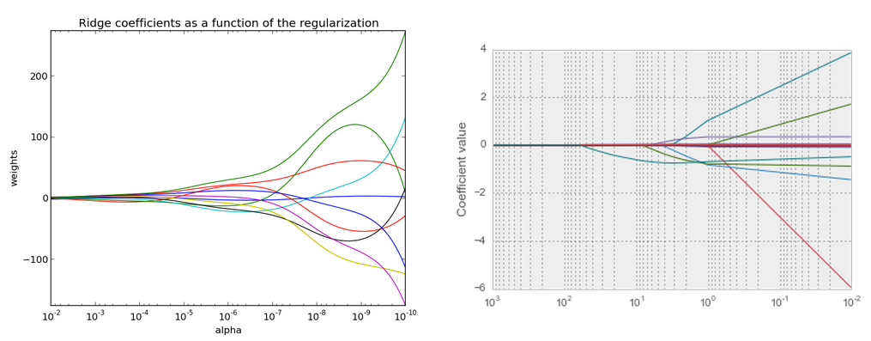
RIDGE VS LASSO

Slide 10
REGULARIZATION
Ridge regression is useful to keep coefficients small, and cope when you don’t have much data
Lasso regression is useful if we believe many features are irrelevant, since a feature with a zero coefficient is essentially removed from the model. Thus, it is a useful technique for feature selection.

Slide 11
ELASTIC NET
Elastic net combines both Ridge and Lasso!
You need to provide a “lambda” for both (called “alpha” and “rho”)…
Or you could use ElasticNetCV and get them by cross-validation

Slide 12
Code example
import sklearn.linear_regression
elastic_net = sklearn.linear_model.ElasticNetCV()
elastic_net.fit(…)
zip(column_names, elastic_net.coef_)

Slide 13
WARNING!!!!
We’ve assumed that all independent variables have roughly the same scale
Ridge, Lasso and ElasticNet will all penalise a large-scale feature
Need to rescale all variables
sklearn.preprocessing.StandardScaler()

Slide 14
What StandardScaler does
Creates a numpy array where each column:
Mean = 0.0
Stddev = 1.0
i.e. subtract the mean from each element, and then divide by stddev
Ideal for
ElasticNet
Lasso
Ridge
K-Means
DBScan
PCA
Makes no difference to DecisionTree, LinearRegression, LogisticRegression

Slide 15
Using StandardScaler
scalerX = sklearn.preprocessing.StandardScaler()
scalerX.fit(X)
(X_train, X_test, y_train, y_test) =
sklearn.cross_validation.train_test_split(X,y)
X_train_scaled = scalerX.transform(X_train)
X_test_scaled = scalerX.transform(X_test)
# optionally transform y…
scalerY = sklearn.preprocessing.StandardScaler()
scalerY.fit(y)
Y_train_scaled = scalerY.transform(y_train)
Y_test_scaled = scalerY.transform(y_test)
Regressor = sklearn.linear_transform.SomeRegressor()
Regressor.fit(X_scaled, Y_train_scaled)
Preds = Regressor.predict(X_test_scaled)
sklearn.metrics.mean_squared_error(Preds, Y_test_scaled)

Slide 16
Getting back to reality
Preds = Regressor.predict(X_test_scaled)
Reality_Preds = scalerY.inverse_transform(Preds)

Slide 17
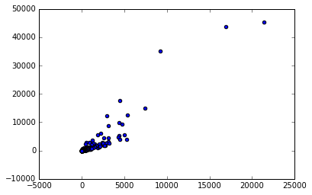
That’s the theory; in practice…
Use RobustScaler() instead
Scales all data
Ignores the top and bottom quartiles to calculate mean and stddev

Slide 18
Linear Regression Summary
Outliers in the X-direction? Theil-Sen
Outliers in the Y-direction? RANSAC
Not enough data? ElasticNetCV or LeastAngleRegression (LARS)

Slide 19
LAB
DATA SCIENCE PART TIME COURSE

